Slide 1
Psychology in education of
Environmental Protection
Lucy Chen

Slide 2
Two parts of the project
Academic
Practical
Psychology in education
Gestalt perception
Positive reinforcement
Ebbinghaus’s forgetting curve
Early school
Subconscious influence
Apply those theories
Color Matching
Reward
Exposure to knowledge
Event time
Environmental protection purpose
Notes:
Research in many articles, pilot studies, looking for possible ways of applying psychology in education, or influencing the behavior of a person
Raising awareness and improve the understanding of recycling in the neighborhood

Slide 3
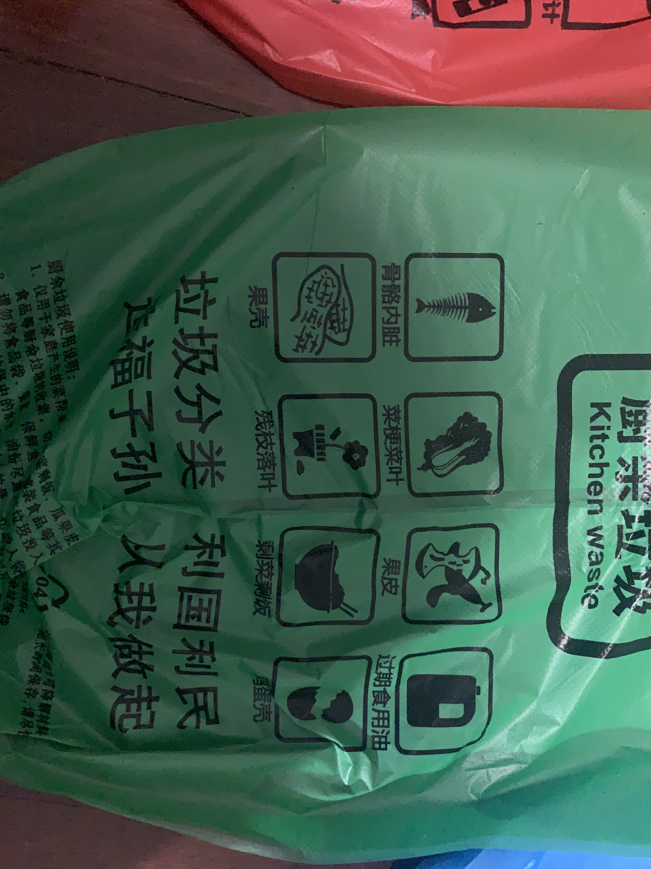
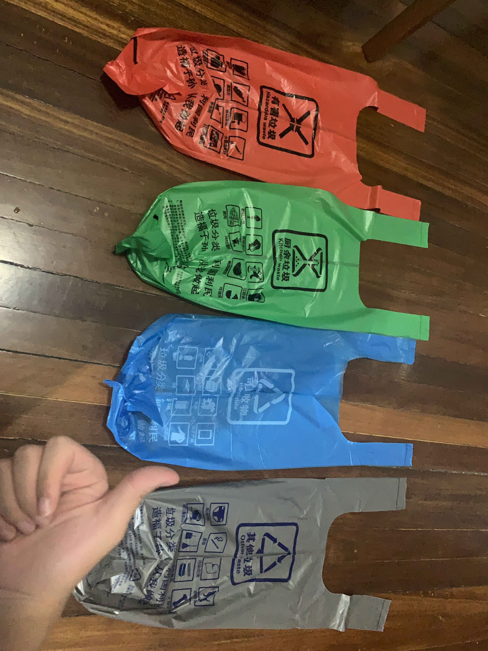
Practical Part
Design Garbage Bags
Notes:
Color Matching and convenient diagram

Slide 4
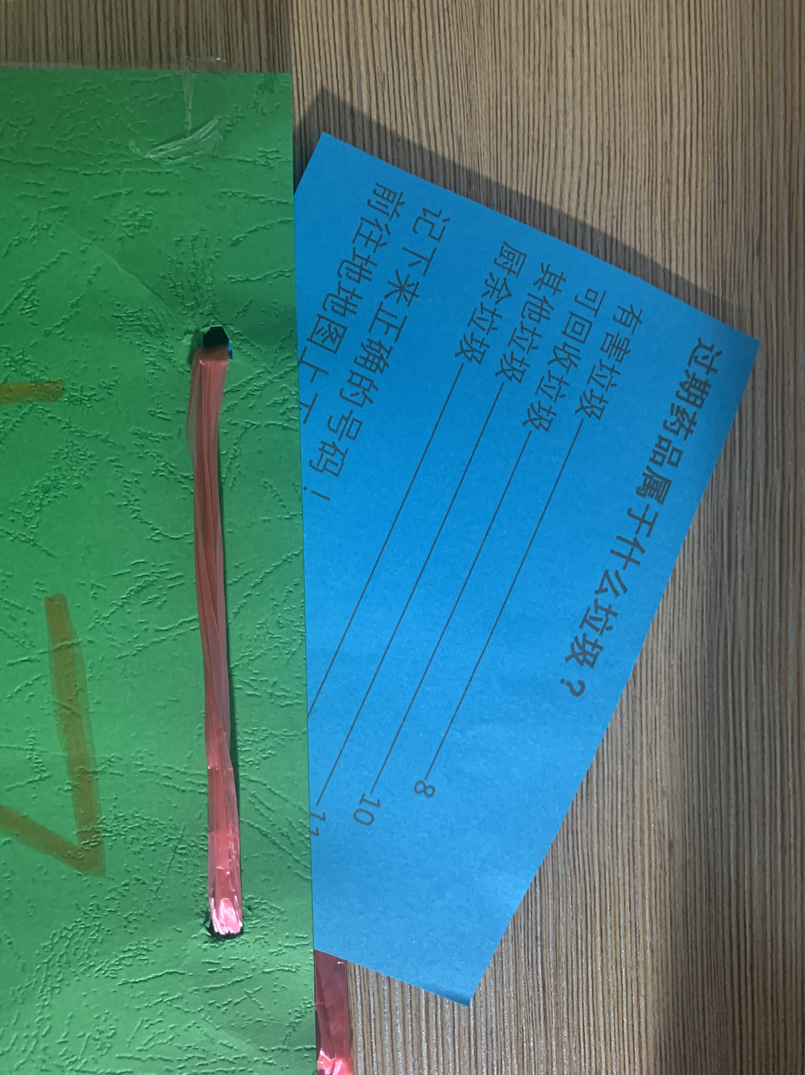
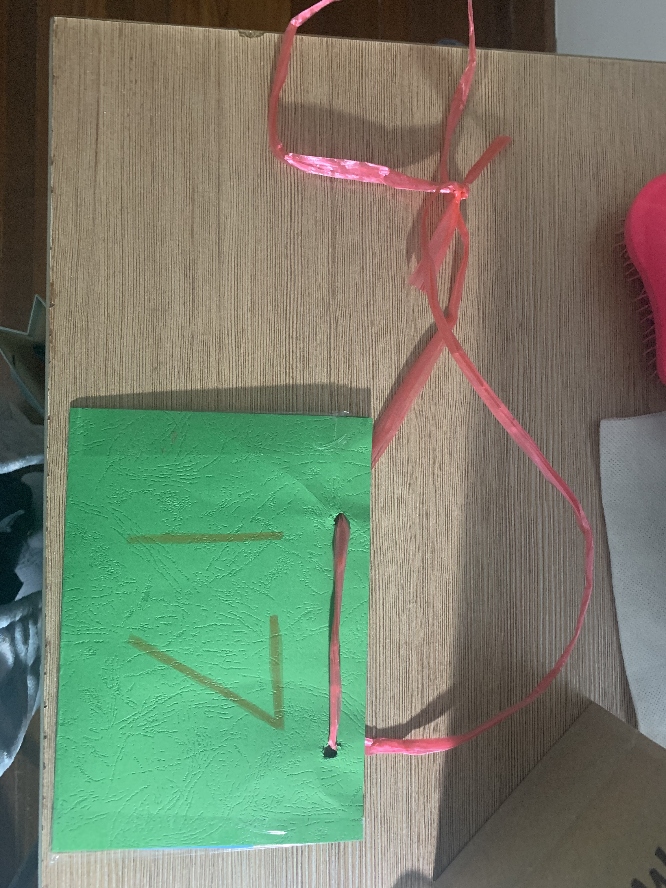
Practical Part
Treasure Hunt Games
Notes:
Explorational games that require children to wander around in the neighborhood, according to the carefully designed map searching and forming correct code for prize (position where usually have many passengers)

Slide 5
Initial Goals
Raising the awareness of the policy
General understanding of recycling standard
Making sure more people are following the regulations strictly.

Slide 6
How?
Score comparison
between pre-assessment
and post-assessment

Slide 7
Initial Goals
Raising the awareness of the policy
General understanding of recycling standard
Making sure more people are following the regulations strictly.
Notes:
Many of them, not merely children, after participating in the event. Know that they are not so skillful at garbage classification at they thought about themselves. They were puzzled by questions!
We Chat Group members: They researched on the internet and re-studied them!

Slide 8
Initial Goals
Raising the awareness of the policy
General understanding of recycling standard (not much as I expected)
Making sure more people are following the regulations strictly.

Slide 9
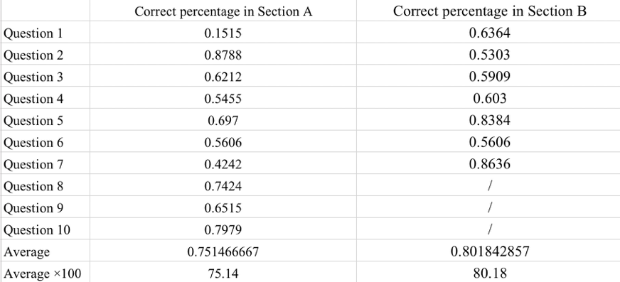
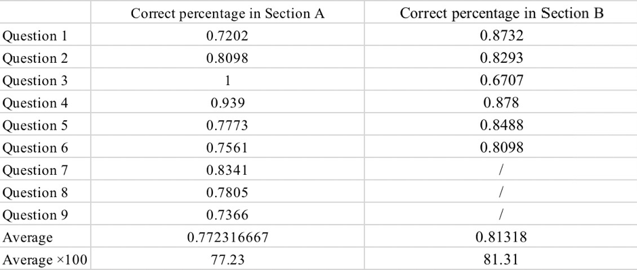
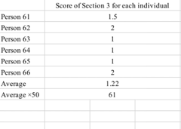
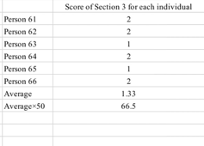
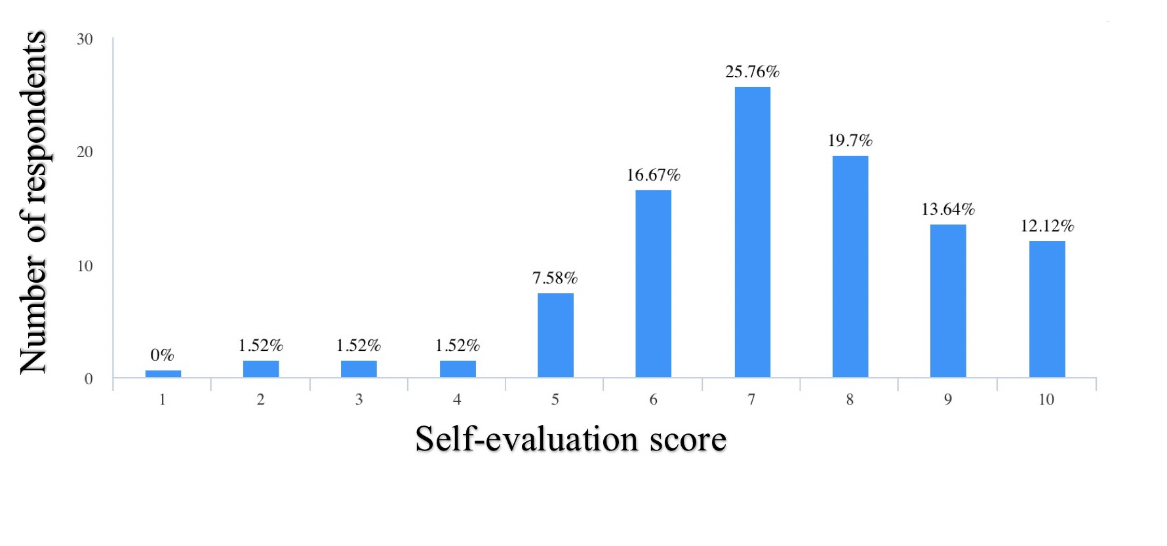
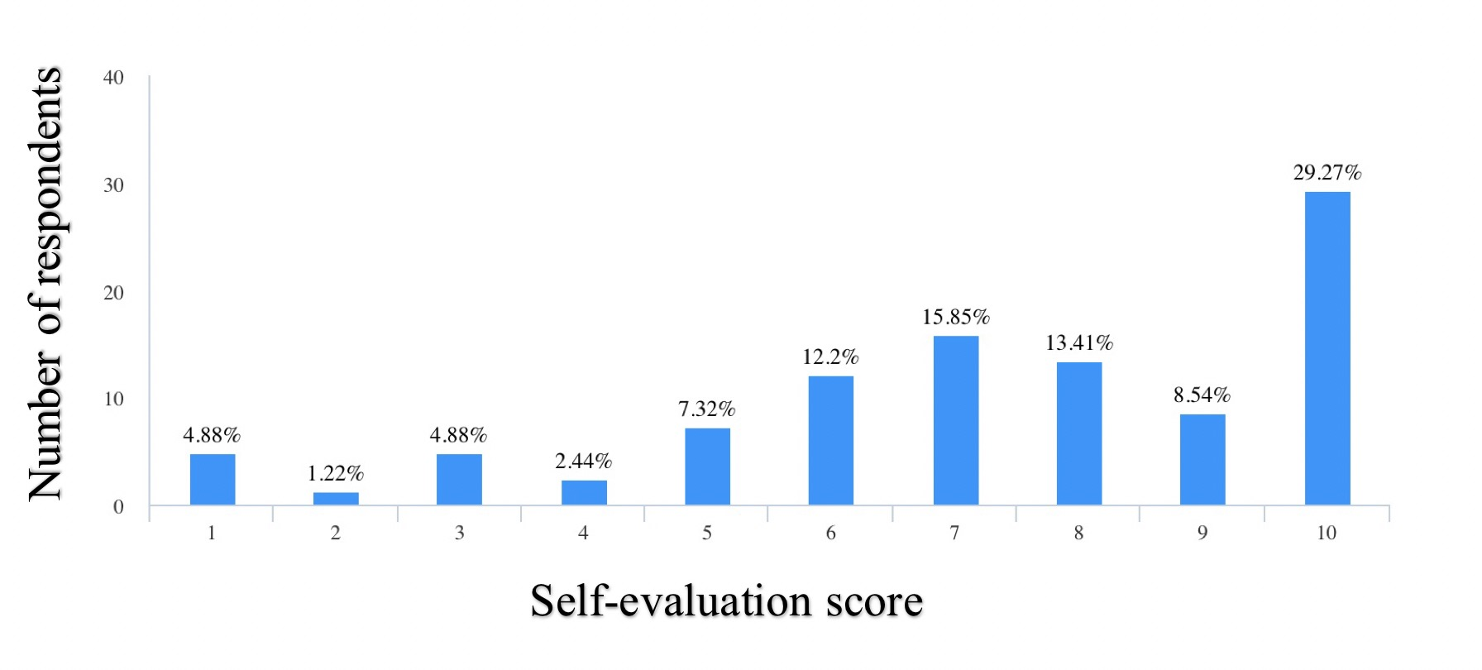
Notes:
Expected a 10% score increase but there are only 1 or 2% of improvements on scores, however, the self score is higher. Probably, after the pre-assessment and event, they re-studied it.

Slide 10
Initial Goals
Raising the awareness of the policy
General understanding of recycling standard (not much as I expected)
Making sure more people are following the regulations strictly.
Notes:
Issue here

Slide 11
Challenges
Special time period and Pandemic
I cannot check every bag of the garbage at disposal point!
Notes:
Due to the Chinese New Year vacation, delivery company stopped working! The time my garbage arrived was delayed for several days. Shorten the time that could put into effect
Pandemic, I cannot gather too much people because of social distancing in my neighborhood
My project was based on the assumptions that people do sort well because either they do not know about the standard or they put them wrongly at the disposal point.
But how about lazy people! Those people who are intentionally disobeying the policy are not considered in my project

Slide 12
The End

Slide 14
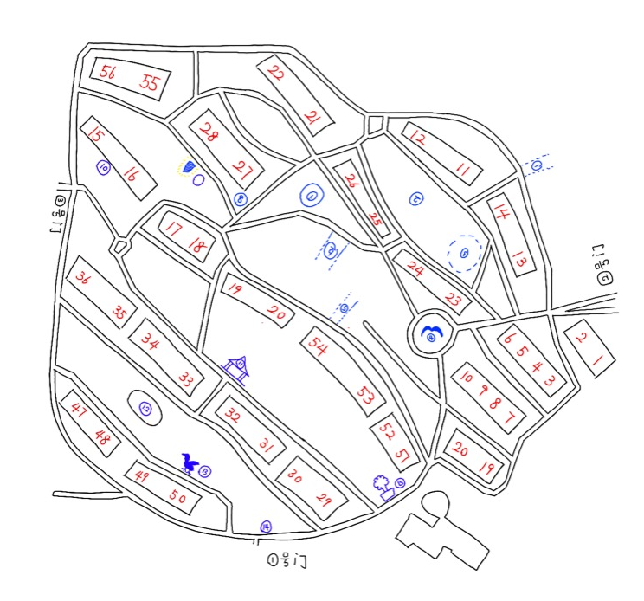
One of the Map
I wander the whole neighborhood completely, choosing corners and spots for the positions of the board cards.
Design the various combination of codes, choosing questions and draw the map

Slide 15
Assessment (little quiz)
1. MCQ
2. T&F
3. Scenario Analysis
4. Self score.
Notes:
Including a subjective self-score

